Slide 1
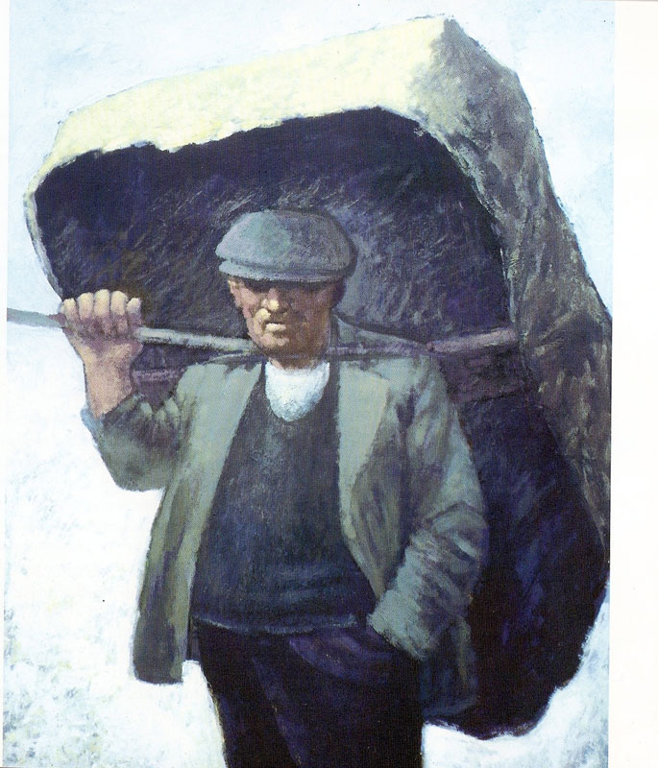
Used with kind permission of Aneurin Jones
A series of interactive lessons and instructions for teachers to create a art project:
Years 5 a 6
Lesson 6
Workers and the workhouse during Victorian Times
Next page
Notes:
1

Slide 2
Observing shape and form of the body (3).
Task for groups between 4-6 pupils: Experiment with bodily poses and record these by creating 3D models using clay.
You must use your imagination during this lesson.
You must imagine that you are a worker from Victorian Times. Try and think of:
- what type of activity the model will be doing?
- how they should stand?
- what emotion will be shown on their face?
- what clothing would they be wearing during this period?
Your teacher is looking for good use of recording bodily poses of workers during the Victorian period.
Previous page
Next page

Slide 3
Observing shape and form of the body (3).
Key words:
Shape
Form
Pose
Light and shadow
Texture
Teimladau
Blinder
Gweithwyr
Tlodi
Dillad carpiog
Feelings
Tiredness
Workers
Poor
Ragged clothes
Equipment available:
Clay
Moulding and marking equipment
Concentrate on the following elements:
Shape and form of the body
Emotion shown on the face
What parts of the body are used to show pain or tiredness?
Previous page
Next page

Slide 4
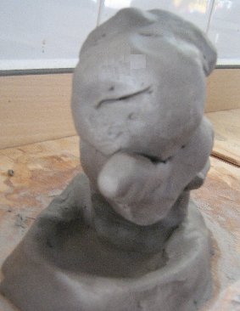
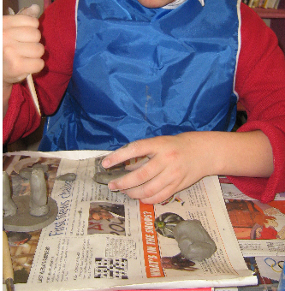
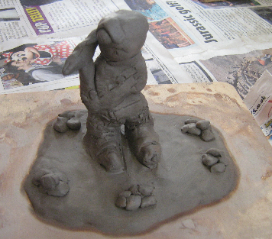
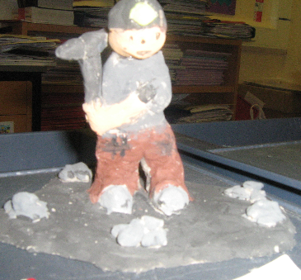
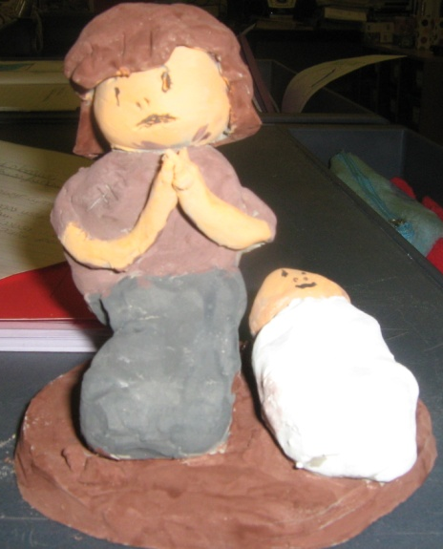
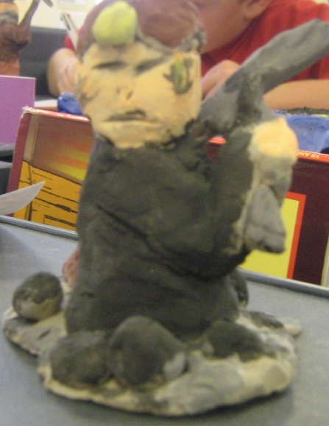
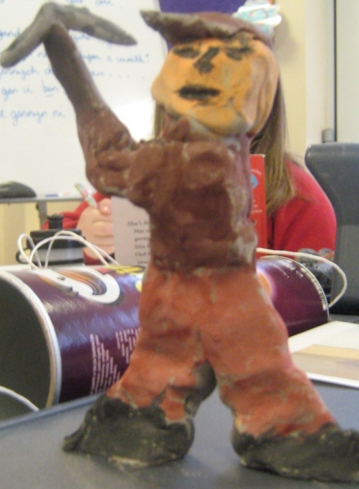
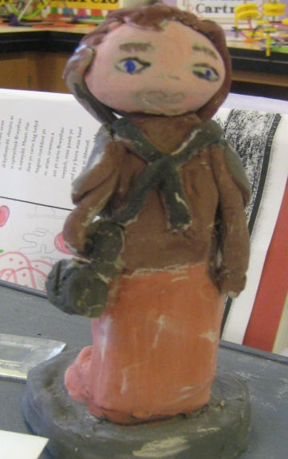
The process in pictures
Finished examples
Previous page

